Slide 1


DE-HOAXI-FIED
Identifying Fake news from Real

Slide 2
Table of Contents
Problem Statement
Intro Video
Design Description
Experiment and results
Shortfall Identification

Slide 3
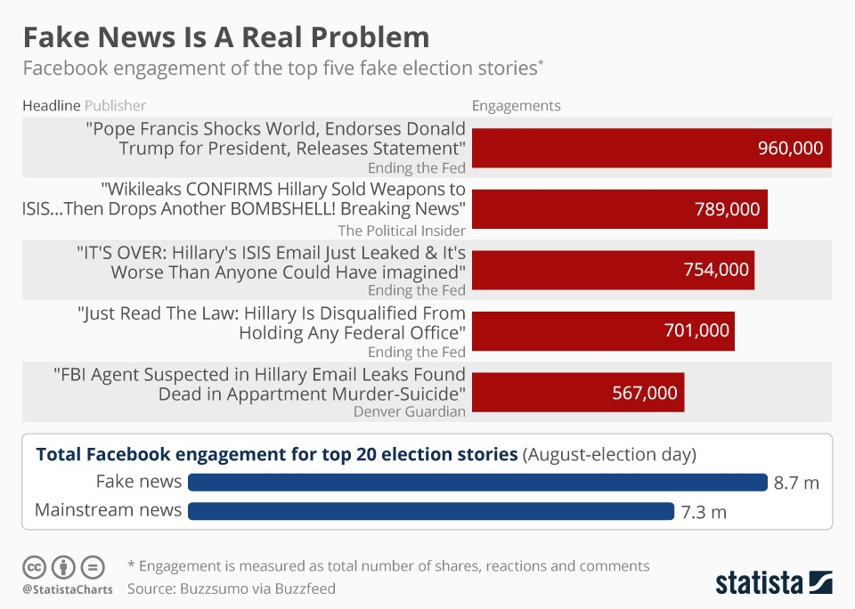
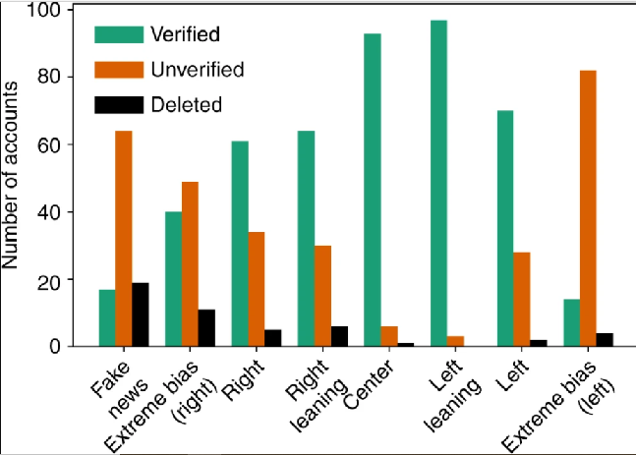
During the 2016 US presidential election, various kinds of fake news about the candidates were widely spread in the online social networks, which may have a significant effect on the election results.
Why Fake news is even a problem?
All together, fake and conspiracy sites published more than 6 million tweets in the month before the election.

Slide 4
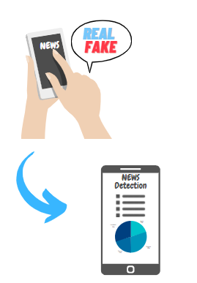
Problem Statement
Objective
Social media has become the main channel for generating fake news.
Spread of inaccurate news.
Immediate need for automatically tagging and detecting such manipulated news articles.
But, tagging the news as real or fake without human intervention is not a correct solution.
To design a solution framework to automatically tag the news as agree,disagree,discuss, and unrelated stance between News headline and News articles

Slide 5
No-Check
Hear Fake News
Fake News gets Viral
Panic Alarming Situation
Fake News
Check Fake News
Fake News gets detected
Eye Opener
Check
Fake News

Slide 6


Slide 7
Data Source
Train: 30000
Validation: 19972
Test: 25413
Real Articles: 1151
Fake Articles: 623
Created Data
Using Combinations
Real Time Data
(Using Web Scraping)
REAL TIME
FNC
Unique
Headline: 1669
Article: 1669
Real claims: 101
Fake claims: 75
Labelled Data
Unlabelled Data
(We used this as Real time test Data )

Slide 8



Web Scraping
List of 167 News Paper created (India and Global+Regional).
URL scrapped from Google are compare with this List.
List of Newspaper
If the URL is in list of Authenticate Newspapers
User Input Claim
Keywords Extraction
Claim Search
Web Scraper
Part of Speech extracted from Claim.
For refine and accurate search.
Search top 500 related article from google on the basis google’s Pagerank Algorithm
Scrap the Article from the Newspapers as per the List
Claim related article not found.

Slide 9
Text-Preprocessing
Web Scraper
Scrapped Articles
Claim Feature Matrix
Combine Feature Matrix
Text pre-Processing:
•Noise Removal
•Lemmatization
•Stemming
•Part Of Speech Tagging
Stop Words
Feature Selection:
•Jaccard Similarity.
•LDA Topic Modelling.
•Glove-TF-IDF
•K1 Divergence.
•N-gram(Tri-Gram).
Semantic Similarity
Article Feature Matrix

Slide 10
Feature Selection
Jaccard Similarity Nouns
Sorts Nouns from Headline & Articles
J(A,B) : |A n B|
|A U B|
LDA Topic Modelling
Based on model assigned topic checks topic commonness in headline and article
Semantic Similarity
Checks (Semantic meaning) between articles and headline
Feature Selection
Glove Similarity
word-word co-occurrence statistics from a corpus, and the resulting representations showcase vector space
K-L Divergence
The value within the sum is the divergence for a given event. Vector of each headline and article is created and then technique is applied
N-Grams
Feature N-Grams are a set of co-occurring words within a given window size and when computing the n-grams we typically move one word forward

Slide 11
Baseline Model
If the number of Unrelated article is more than Threshold value.
(No. of Unrelated article > 51%)
Combine Feature Matrix
Un-Related
2 Class Classifier
(After comparing different classifier model, we have choose to go with Random Forest Classifier)
Articles and Headline with class as Related are filtered on the basis of the unique ID.
And will be passed into BART summarizer.
Related

Slide 12
Deep Learning Model
Articles and Headline with class as Related are filtered on the basis of the unique ID.
And will be passed into BART summarizer.
Agree %
Discuss %
3 Class BERT Model:
NN will classify Article in either one of the Agree, Disagree or Discuss
BART Summarizer
Disagree %
1. It is a Transformer that combines the Bidirectional Encoder (i.e. BERT like) with an Autoregressive decoder (i.e. GPT like) into one Seq2Seq model.
2. It is required to avoid information loss during prediction task.
1. It capture the contextual meaning of the headline and article.
2. We need to fine tune this model for classification task.
3. Label with maximum probability will be given as output.

Slide 13
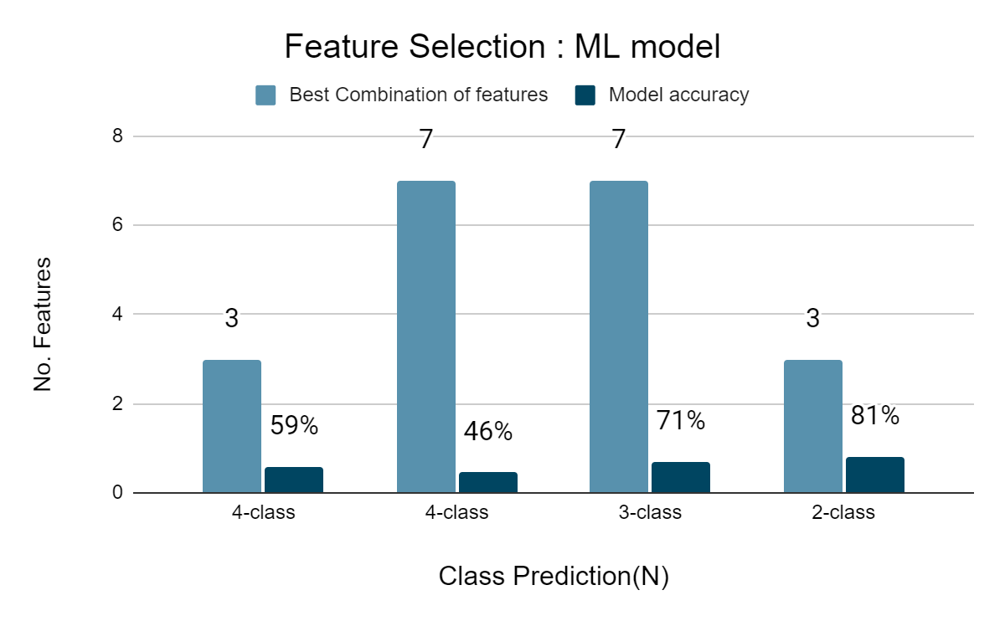
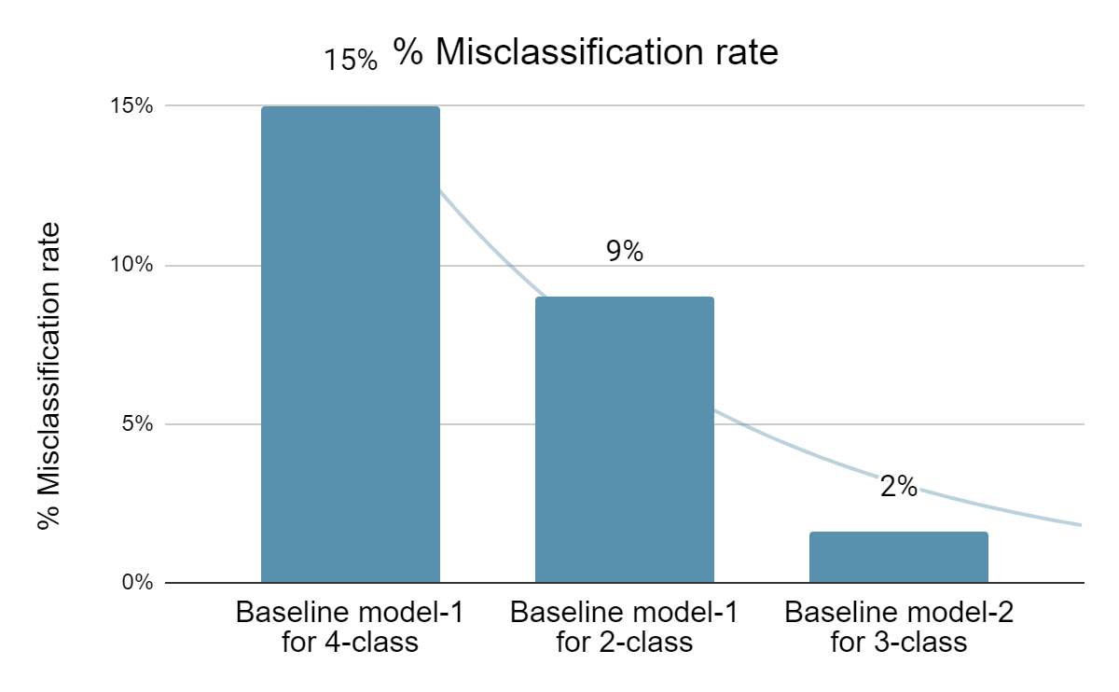
Model Selection
Stage-1
85%
Train Accuracy
Machine Learning Model
RandomForest
Classifier
Real-time
Stage-2
98%
Train Accuracy
Transformer-
Based Model -BERT
Real-time
66%
Comparing Performance of
7 Machine Learning
Models on FNC-1
Fine-tune Pre-trained
Model for
Classification
Task-3 class

Slide 14
Real time Analysis of Claims

Slide 15
Experimental Result
Real-time
Data
Baseline
Model-1
Baseline
Model-2
Machine Learning Model
Transformer-Based Model -BERT
Data collection
175
1774
1246
528
886
75
134
101
74
65%
35%
68%
32%
57%
43%
Total News articles
Related articles
Unrelated articles
Agree
Disagree
Discuss
Total Claims
Real
Fake
Real
Fake
Real
Fake
Real
Fake
Real
73%
Fake
27%
Real
32%
Fake
68%
Real
64%
Fake
36%
1. Article Scraped for real claim are 1157 and fake claim are 623.
2. On an average 11 article per real claim and 8 article per fake claim.
1. 848 out of 1157 real article are related to claim. Where as only 63% are related for fake.
2. For a claim to pass through ML model it should atleast have 51% related article
1.For the Article to Fake we have proposed a threshold in to steps: a) No. of agree articles should be less than disagree plus discuss. b) No. of Disagree articles should be greater than equal to discuss.
2. For business problem our concern is not to miss-classify fake as real, as compare to opposite

Slide 16
Shortfall Identification
Future Scope
Real-time
175
The amount of data is not enough for concluding anything related to threshold for further classification of claim into Fake or Real
Train model
on even more large
data, equal
real and fake claims
Fake-74
Real-101
Baseline model-1
Differentiate the newspapers which have direct and manipulative writing style
1.To pass more claim into the Second Model, we put the threshold for first model at 51%.
2. Need to work on with more Data to set the threshold for Model-1
Fake
News
Threshold on Predicted output
Real News
Baseline model-2
Add weightage to newspapers based on their past prediction accuracy
1.As per the requirement of the Business problem we have created the biased threshold for the Model-2
2. We have predicted 55 out 74 fake news but around 65 real news were misclassified in the process.
Threshold on Predicted output
Fake-55
Real-26
Add more weightage
to regional newspapers for regional claims

Slide 17






Anurag Sharma
Atul Pandey
Deepak Sharma
Pooja N
Shreyansh Bhalodiya
Mentor- Prof Gourab Nath

Slide 18
Thank you

